Slide 1
Numerical Computing Through python
This presentation will explore Secant Method practical task using Python and their libraries
Santosh {22F-BSAI-63}
Rafay {22F-BSAI-93}
Ahtram {22F-BSAI-99}
Reshmil {22F-BSAI-116}

Slide 2

Here is the link of the git hub repository of practical application of numerical computing of extracting the real information of real life data
https://github.com/SantoshMalhi/Numerical-Project
Created by : Santosh[63]

Slide 3

Overview of Secant Method
The Secant Method is a numerical technique used to find the roots of a real-valued function. Unlike the Newton-Raphson method, which requires the derivative of the function, the Secant Method approximates the derivative using finite differences. This makes it particularly useful when the derivative of the function is difficult or impossible to calculate.
Key Characteristics:
Formula
Uses of Secant method:
-It uses two initial approximations (x0 and x1) to start the iteration process.
-The method constructs a secant line that intersects the x-axis, providing an approximation to the root.
-Iteratively refines the root estimate until a desired level of accuracy is achieved.
Predict the behavior of complex systems.
Optimize processes in engineering and science.
Enhance the accuracy and efficiency of computational models.

Slide 4
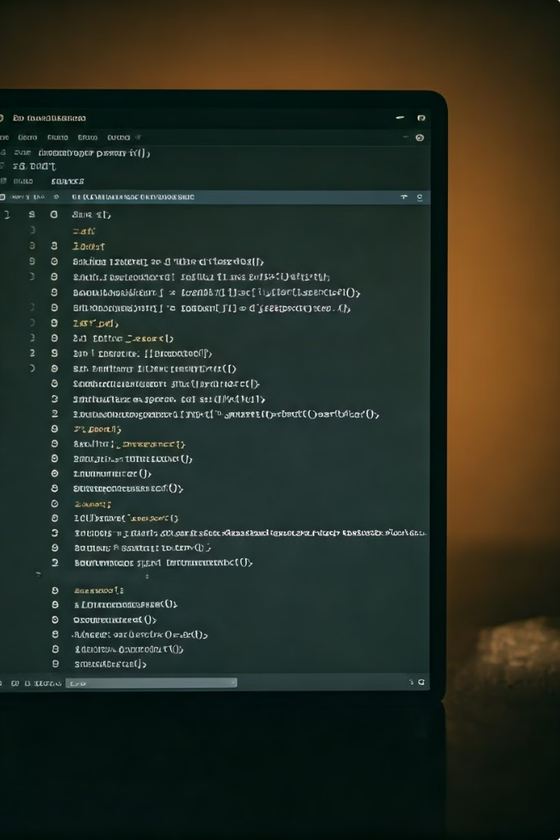
Implementing Secant Method in Python
Python's Numerical Methods provide powerful tools for finding roots of equations, making it easy to implement the Secant Method.
1
Step 1: Define the Function
2
Step 2: Choose the initial Guess
Create the function f(x) for which you want to find the root.
Select two initial approximations x0 and x1
3
Step 3: Implement the Iterative Formula
4
Step 4: Check for Convergence
Continue iterations until the difference between successive approximations is less than a specified tolerance.
Use the Secant Method formula to iteratively update the root estimate.

Slide 5
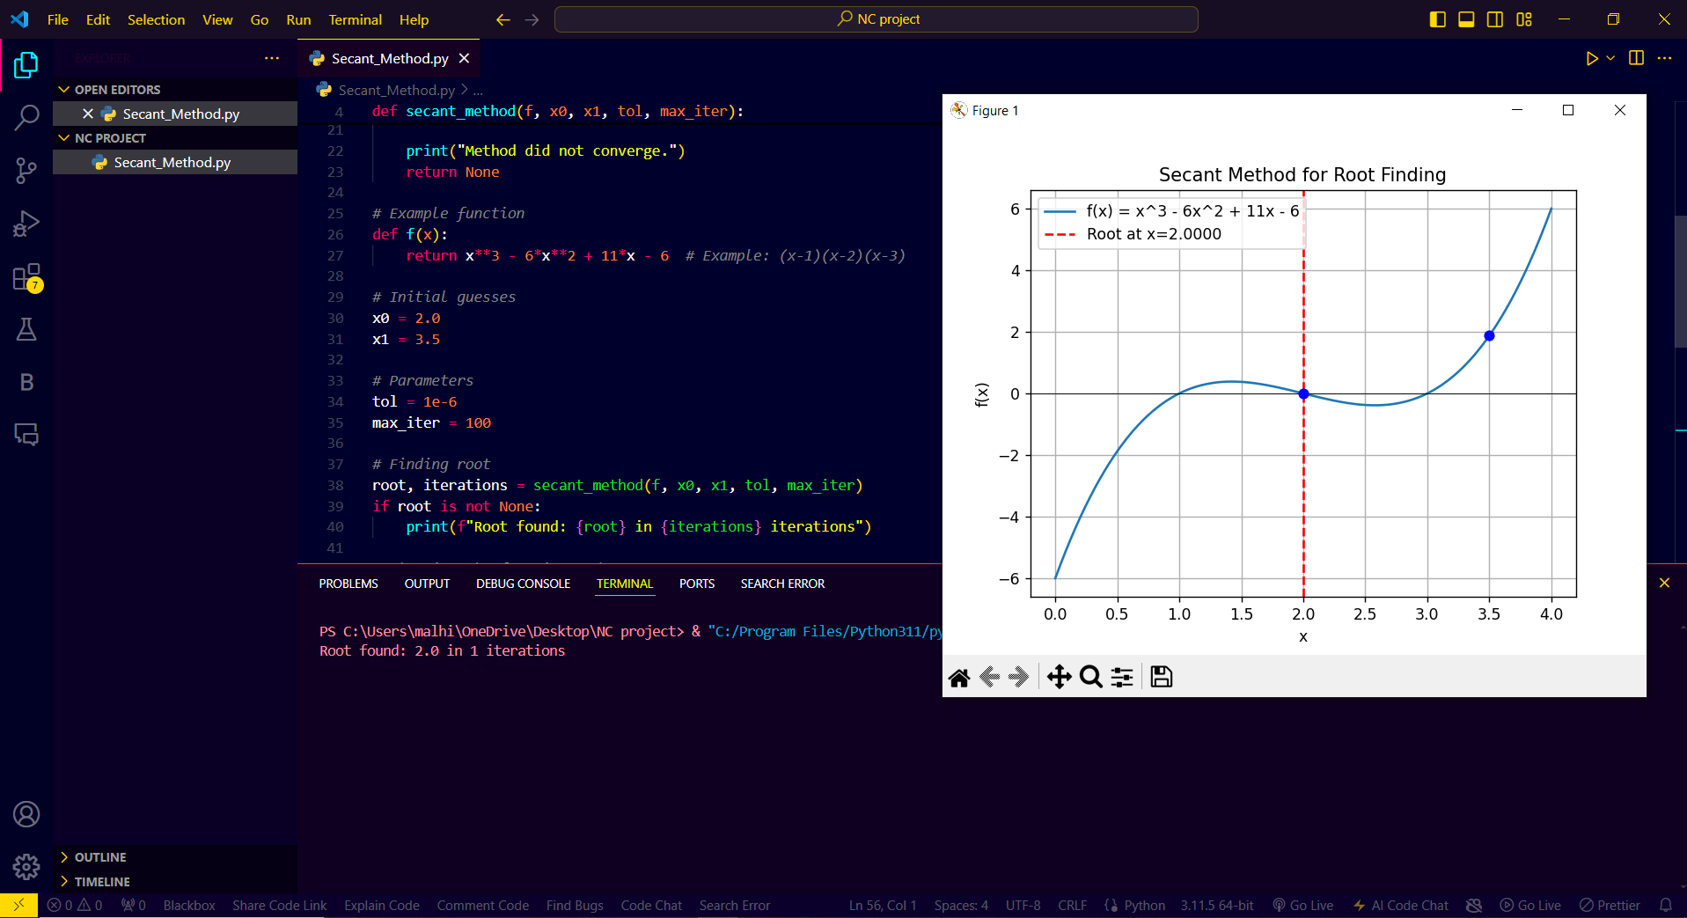

Slide 6
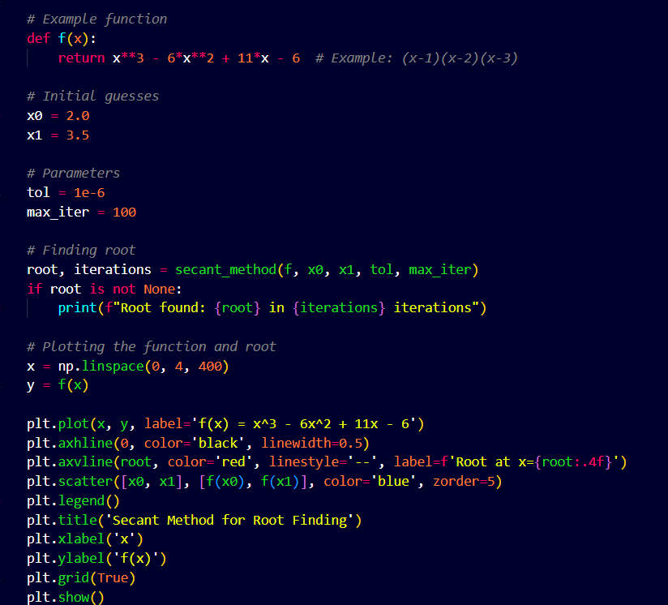
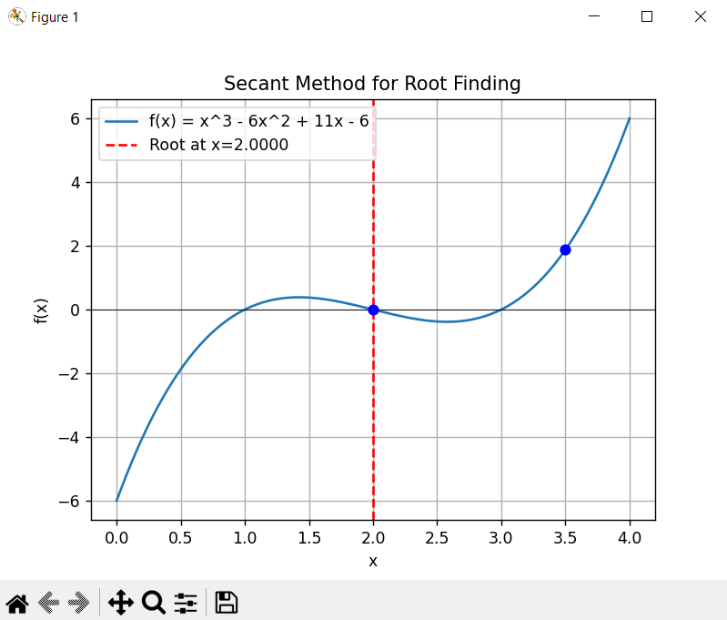

Slide 7
